Slide 1

Did the Russian/Ukraine War Effect Commodity Prices in the US?
Presented by: Crystal Butler, James Senger, John Quinn, and Jared Worrick

Slide 2
Jared

Slide 3
Jared

Slide 4
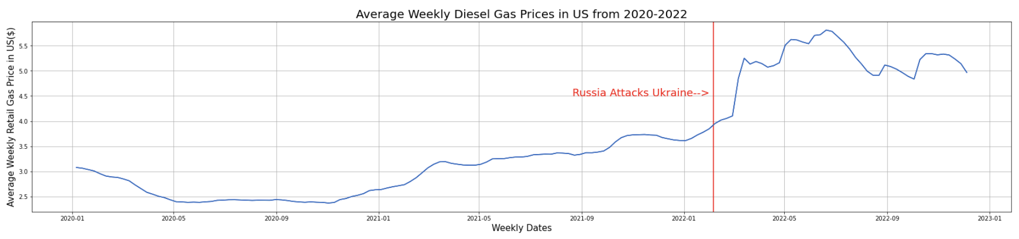
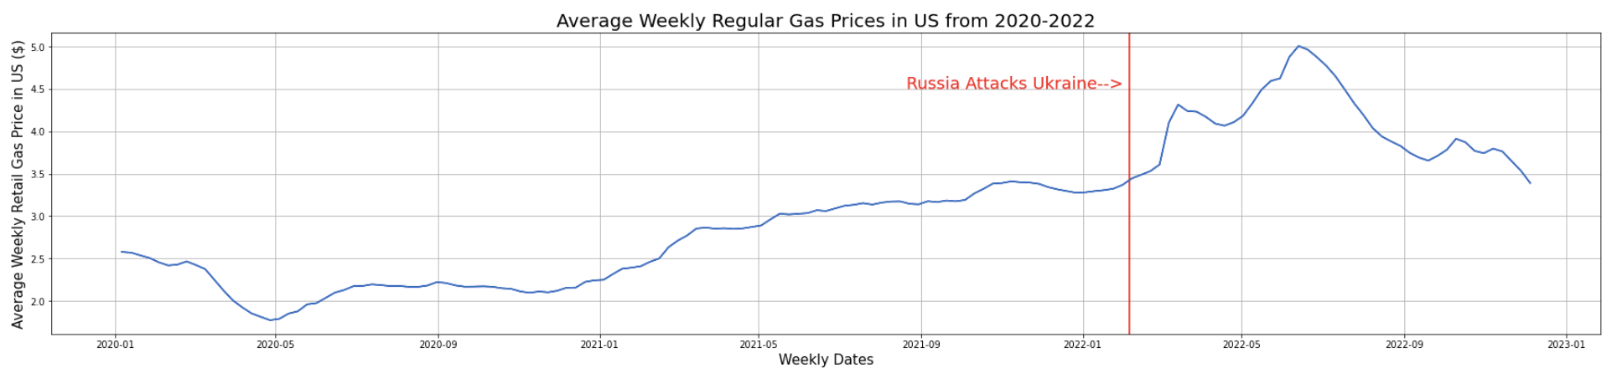
According to data pulled from EIA.gov, Diesel and Regular Gas Prices Increased at a significantly higher rate directly after Russia attacks Ukraine on February 24, 2022
By: Crystal Butler

Slide 5
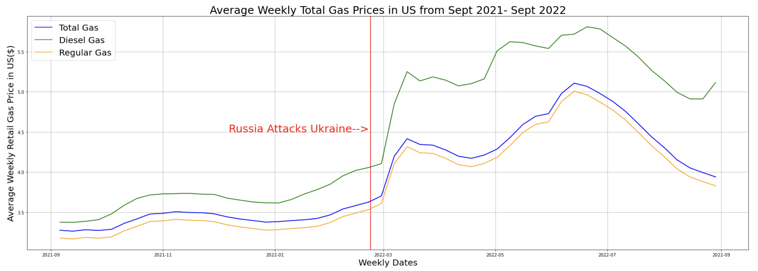
Comparing the data side by side, you can see that the Diesel gasoline was much more volatile to the start of the Ukraine War than regular gasoline. Diesel’s rate of increase was over twice the rate of Regular gasoline. Regular Gasoline increased $0.60 in two months while Diesel increased $1.40 in that same timeframe.
By: Crystal Butler

Slide 6
John

Slide 7
John

Slide 8
James

Slide 9
James

Slide 10

FINAL CONCLUSIONS
Russia’s attack on Ukraine affected many commodity prices in the US almost immediately.
Gasoline prices increased as a much higher rate than they were increasing up until that point
Grain prices…
The Russian Ruble….
Where we got our fuel….

